Slide 1
Function of two or more variables Session 10-12
Course : Calculus I
Year : 2015

Slide 2
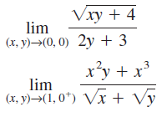
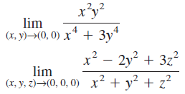

Sketch several level curves for the function
Find the limit or show that it does not exist
a. c.
b. d.
Find the second partial derivatives of the function.
a.
b. .

Slide 3

4. Find the direction in which increases most rapidly at the point (4,1). What is the maximum rate of increase?
5. Find the relative extrema and saddle points of the function.
7. Find the absolute extrema of
on the set

